Slide 1
Digital Electronics
Principles & Applications
Seventh Edition
Roger L. Tokheim
Chapter 4
Using Logic Gates
©2008 The McGraw-Hill Companies, Inc. All rights reserved.

Slide 2
INTRODUCTION
Logic Circuit from a Boolean expression
Minterm and maxterm Boolean expressions
Boolean expression from a truth table
Truth table from a Boolean expression
Simplifying Boolean expressions
Karnaugh mapping

Slide 3
INTRODUCTION (continued)
Variations in Boolean expressions
DeMorgan’s theorem
PLDs (programmable logic devices)

Slide 4


“Tools of the Trade”
for Solving Logic Problems
Gate symbols
Truth tables
Boolean expressions
Combinational logic circuits:
AND-OR pattern of gates
from
Sum-of-products Boolean expression such as:
AB + CD = Y
AND-OR pattern of gates
OR-AND pattern of gates
from
Product-of-sums Boolean expression such as:
(A+B) (C+D) = Y
OR-AND pattern of gates

Slide 5


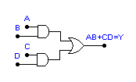
Logic Circuit From Boolean Expression
Example:
Draw the AND-OR logic diagram for the Boolean expression:
AB + CD = Y
Step 1: OR AB with CD
Step 2: Add top AND gate
Step 3: Add bottom AND gate
©2008 The McGraw-Hill Companies, Inc. All rights reserved.

Slide 6

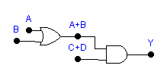
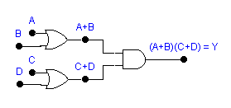
QUIZ
Draw the OR-AND logic diagram for the Boolean expression:
(A+B) • (C+D) = Y
Step 1:
Step 2:
Step 3:

Slide 7
Boolean Expressions
Sum-of-products form:
A • B + C • D = Y
Also called the minterm form
Product-of-sums form:
(A + B) • (C + D) = Y
Also called the maxterm form

Slide 8
QUIZ
1. The Boolean expression AB + BC = Y is in __________ (product-of-sums, sum-of-products) form.
sum-of-products
2. The Boolean expression (A+B) (B+C) + Y is in __________ (product-of-sums, sum-of-products) form.
product-of-sums
3. The Boolean expression (A+B) (B+C) = Y is in __________ (maxterm, minterm) form.
maxterm
4. The Boolean expression AB + BC = Y is in __________ (maxterm, minterm) form.
minterm

Slide 9
Boolean Expression from Truth Table
Write the Boolean expression that describes the logic in this truth table.
Truth Table
Input Output
ABC Y
Step 1: Focus only on the truth table lines
with outputs of 1.
0 0 0 0
0 0 1 0
0 1 0 1
0 1 1 0
1 0 0 0
1 0 1 0
1 1 0 0
1 1 1 1
Step 2: AND the inputs for these two lines
and logically OR the ANDed groups.
A • B • C
+
A • B • C = Y
Minterm Boolean expression:
A B C
+
A B C = Y

Slide 10
QUIZ
Truth Table
Input Output
ABC Y
Write the Boolean expression that describes the logic in this truth table.
0 0 0 1
0 0 1 0
0 1 0 0
0 1 1 0
1 0 0 0
1 0 1 0
1 1 0 0
1 1 1 1
A • B • C
+
A • B • C = Y
Minterm Boolean expression:
A B C
+
A B C = Y

Slide 11
QUIZ
Truth Table
Input Output
ABC Y
1. Write the sum-of-products Boolean expression for this truth table.
______________________________
A’BC + ABC = Y
0 0 0
0 0 1
0 1 0
0 1 1
1 0 0
1 0 1
1 1 0
1 1 1
0
0
0
1
0
0
0
1
2. Write the minterm Boolean expression for this truth table.
______________________________
A’BC + ABC = Y

Slide 12
Truth Table From Boolean Expressions
Fill in a truth table from a minterm Boolean Expression.
Minterm Boolean expression:
A•B•C
+
A•B•C
+
A•B•C
= Y
Truth Table
Input Output
ABC Y
Step 1: Place three 1s
in output column.
1
0 0 0
0 0 1
0 1 0
0 1 1
1 0 0
1 0 1
1 1 0
1 1 1
0
0
Step 2: Place five 0s in blanks in output column of truth table.
1
0
0
1
0

Slide 13
QUIZ
1. Fill in the output column of the truth table for the Boolean expression A’B’C’ + ABC’ = Y.
Truth Table
Input Output
ABC Y
0 0 0
0 0 1
0 1 0
0 1 1
1 0 0
1 0 1
1 1 0
1 1 1
1
0
0
0
0
0
1
0

Slide 14
Simplifying Boolean Expressions
Truth Table
Input Output
ABC Y
Unsimplified Boolean Expression
A•B•C
+
A•B•C
+
A•B•C
+
A•B•C
= Y
0 0 0
0 0 1
0 1 0
0 1 1
1 0 0
1 0 1
1 1 0
1 1 1
1
1
0
0
1
This line is not to be considered in the loop.
0
This line is not to be considered in the loop.
This line is not to be considered in the loop.
This line is not to be considered in the loop.
1
0
Simplified Expression:
A•C
+
A•B
= Y
RULE:
Eliminate term within loop that contains a term and its complement.

Slide 15
Simplify Boolean Expression
(Karnaugh map method)
Unsimplified Boolean expression (3 variables):
A•B•C
+
A•B•C
+
A•B•C
+
A•B•C
= Y
_
C C
Step 1: Plot 1s
_ _
A B
C
Step 2: Loop groups
1
1
_
A B
Step 3: Eliminate variables
Step 4: Form simplified
minterm expression
A B
1
_
A B
1
B
B
C
C
Simplified Expression:
A C
+
A B
= Y

Slide 16
QUIZ
Simplify Boolean Expression
(Karnaugh map method)
Unsimplified Boolean expression (4 variables):
ABCD
+
ABCD
+
ABCD
+
ABCD
= Y
Step 1: Plot 1s
_ _ _
C D C D
_
C D C D
Step 2: Loop groups
_ _
A B
1
1
Step 3: Eliminate variables
_
A B
Step 4: Form simplified minterm expression
A B
1
_
A B
1
B
B
D
D
Simplified Expression:
ACD
+
ABC
= Y

Slide 17
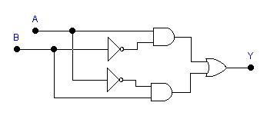
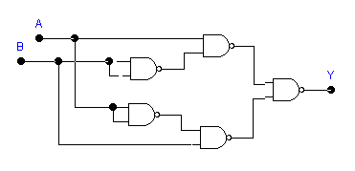
Developing a NAND Logic Diagram
Minterm expression: AB + AB = Y
Step 1: Draw AND-OR logic diagram from minterm expression.
Step 2: Substitute NAND gates for each inverter, AND, and OR gate.
NOTE: Both logic diagrams will generate the same truth table.

Slide 18
Variations in Boolean Expressions
Boolean expression (textbook style):
A B + C D = Y
A + B = Y
A B = Y
Boolean expression (keyboard style):
A’B + CD’ = Y
(A + B)’ = Y
A’ B’ = Y

Slide 19
QUIZ
1. The Boolean expression A B + C D = Y is written as _______ in keyboard style.
A B’ + C’D = Y
2. The Boolean expression A+B+C = Y is written as _______ in keyboard style.
(A+B+C)’ = Y
3. The Boolean expression A B C = Y is written as _______ in keyboard style.
A’ B’ C’ = Y

Slide 20
DeMorgan’s Theorems
First theorem:
A + B = A B
Both used
to eliminate
long overbars
Second theorem:
A B = A + B

Slide 21
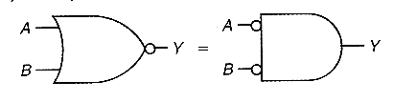
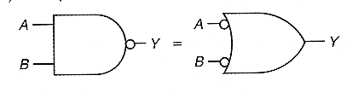
DeMorgan’s Theorems
First theorem:
A + B = A B
Second theorem:
A B = A + B

Slide 22
QUIZ
The statement A B = A + B is DeMorgan’s __________ (first, second) theorem and suggests converting from a NAND to an OR situation.
second
2. The statement A + B = A B is DeMorgan’s __________ (first, second) theorem and suggests converting from a NOR to an AND situation.
first

